Slide 1
Holistic Services in An Acute Care Hospital setting A Ten-Year Journey from Vision to Culture Change
Kathleen O’Kane BSN, RN, HWNC-BC, CCAP
Amy Luckman, BSN, RN, CPN, HWNC-BC
Christina Rossi, RN, MSN, AHN-BC, HWNC-BC

Slide 2
Objectives
Understand the role of certified holistic nurses and other holistic practitioners in improving staff resilience and patient/family caregiver experience Outline the scope of services that your holistic team can offer or support to improve your organization’s staff's sense of well-being and patient/family experience Recognize the importance of executive leadership in building and sustaining your holistic services program

Slide 3
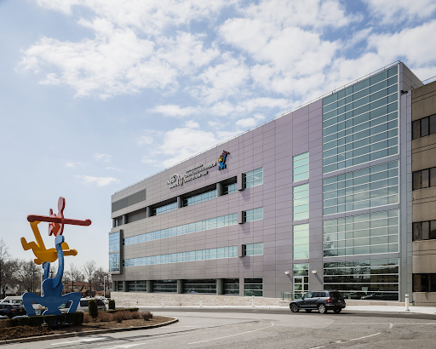
Cohen Children’s Medical Center A Division of Northwell Health
Level 1 Pediatric Trauma Center #2 Children’s Hospital in NYS Largest provider of pediatric healthcare on LI
U.S. News & World Report Best Children’s Hospitals Ranked in 8 out of 10 clinical areas
Attained Magnet Designation in 2016/2020
The 13th National Site for the Ryan Seacrest Studio for Children
206 bed Level 1 Trauma designated facility in
New Hyde Park, NY

Slide 4
Our team
Certified Holistic Nurses/Coach
Kathleen O’Kane, BSN, RN, HWNC-BC
Christina Rossi, MSN, RN, AHN-BC, HWNC-BC
Joanne Zayas, RN, HWNC-BC
Amy Luckman BSN, RN, CPN, HWNC-BC
Reiki Master Practitioners
Mary Lou Guerra Constance Korol
Phyllis Quinlan, PhD, RN, NPD-BC Internal Coach/Program Director

Slide 6
Nursing approach that focuses on healing the whole person
Honors relationship-centered care and the interconnectedness of self, others, nature, and spirituality
Promotes and optimizes health and wellness and incorporates integrative, complementary, and alternative approaches
From the chapter entitled, Nursing History & the Evolution of Holistic Nursing. Mary Ann Cordeau. Dossey & Keegan’s Holistic Nursing (2022)
Holistic Nursing

Slide 7
Why The Program Was Created We Can Do Better for Our Family Caregivers…
2013

Slide 8
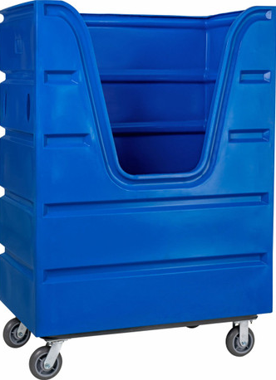
A Compassionate Assessment & A Plan
2012 Developed a business plan/presented it to executive leadership
2013 Equipment was ordered
2013 Time split between NICU and Caregiver program
2013 Per diem holistic nurse brought onboard – Elizabeth
2013 Caregiver Program was initiated
2013 Temporary Room on 4th floor, then “Took Holistic on the Road“
2014 Volunteer Reiki Practitioner Marylou joined our team
Holistic Services on Wheels

Slide 9
Feedback From the Family Caregivers and the Staff
“As a parent who felt the stress of my son’s brain surgery,
I search for ways to give me strength and faith.
Right now, I feel so cared for as a parent.”
“I was truly listened to. The chair massage was so calming. Thank you.”
“This is the most relaxed I’ve been since my son was admitted five weeks ago.”
“I can’t believe how much my stress went down in just 15 minutes.”
“A moment’s peace in the midst of all this stress and chaos.”
Staff
“This is unbelievable. I feel so valued”

Slide 10
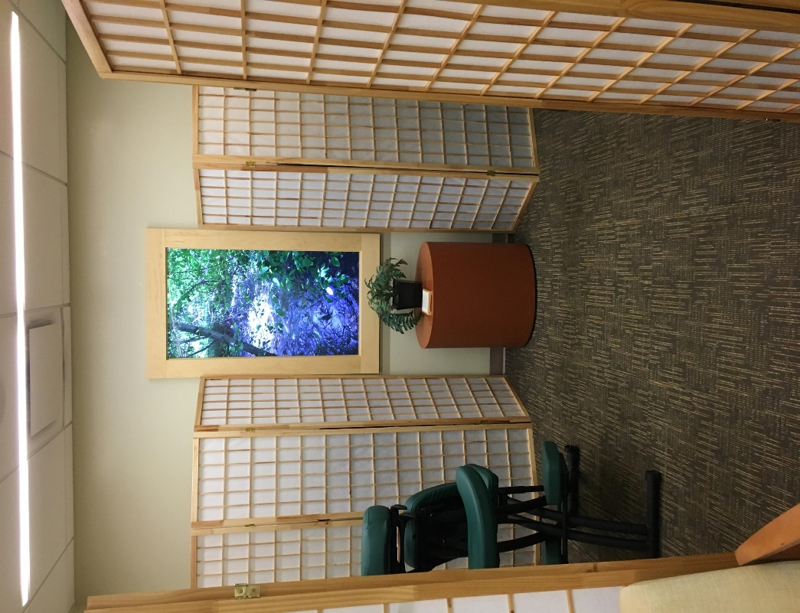
the Serenity suite
2017
Full Time Holistic Nurse
Dedicated space opened for the Caregiver program
2019
Virtual Nature Window donated by a patient’s family

Slide 11
What do the CCMC Holistic Nurses do?
Our focus is on the healing journey not the disease and cure
Some common techniques/therapies include:
Chair Massage (Amma)
Reflexology (Hand & Feet)
Chinese and Eastern Healing Practices/Reiki
Meditation/Guided Imagery
Sound Healing/Tuning Folks
Aromatherapy
Supportive Listening (Very Popular)
Notes:
Active listening and presence. Guidance on the healing journey

Slide 12
AMMA Massage
AMMA MASSAGE
Focuses on the balance and movement of energy in the body
Amma techniques aim to remove blockage and free the flow of energy in the body thereby restoring, promoting, and maintaining optimal health
Notes:
Story about neuroscience mom

Slide 13
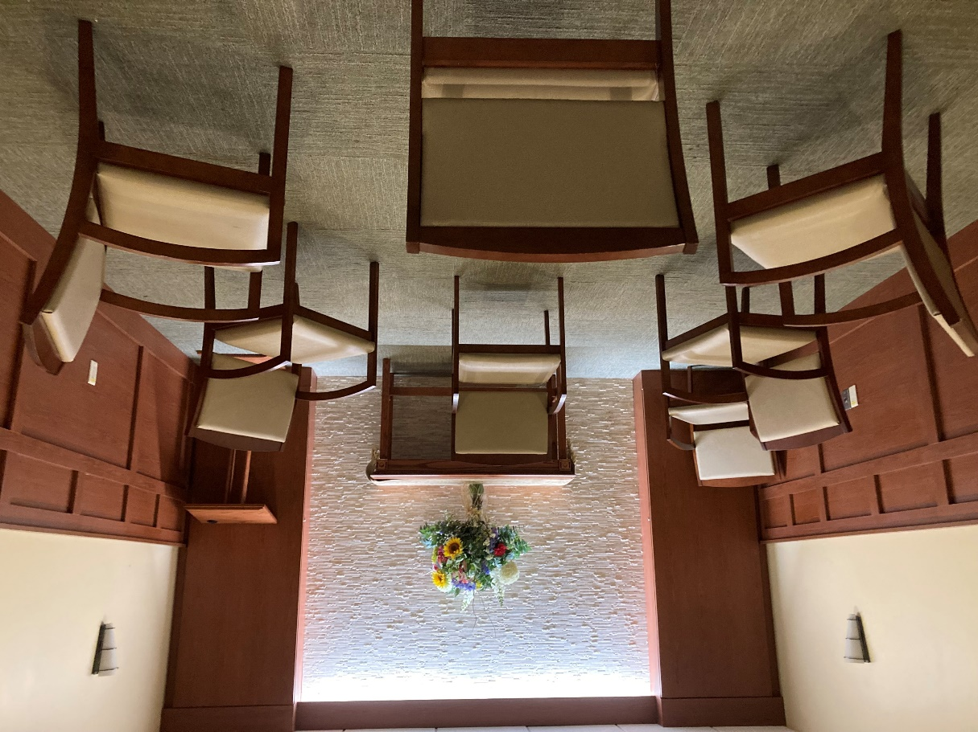
Meditation
Deliberately focusing your attention to increase awareness, calm the mind, or relax the body
We hold weekly meditations sessions in the
Chapel, Administration, and Adolescent Unit
​ ​ ​
Notes:
Brings you out of your head

Slide 14
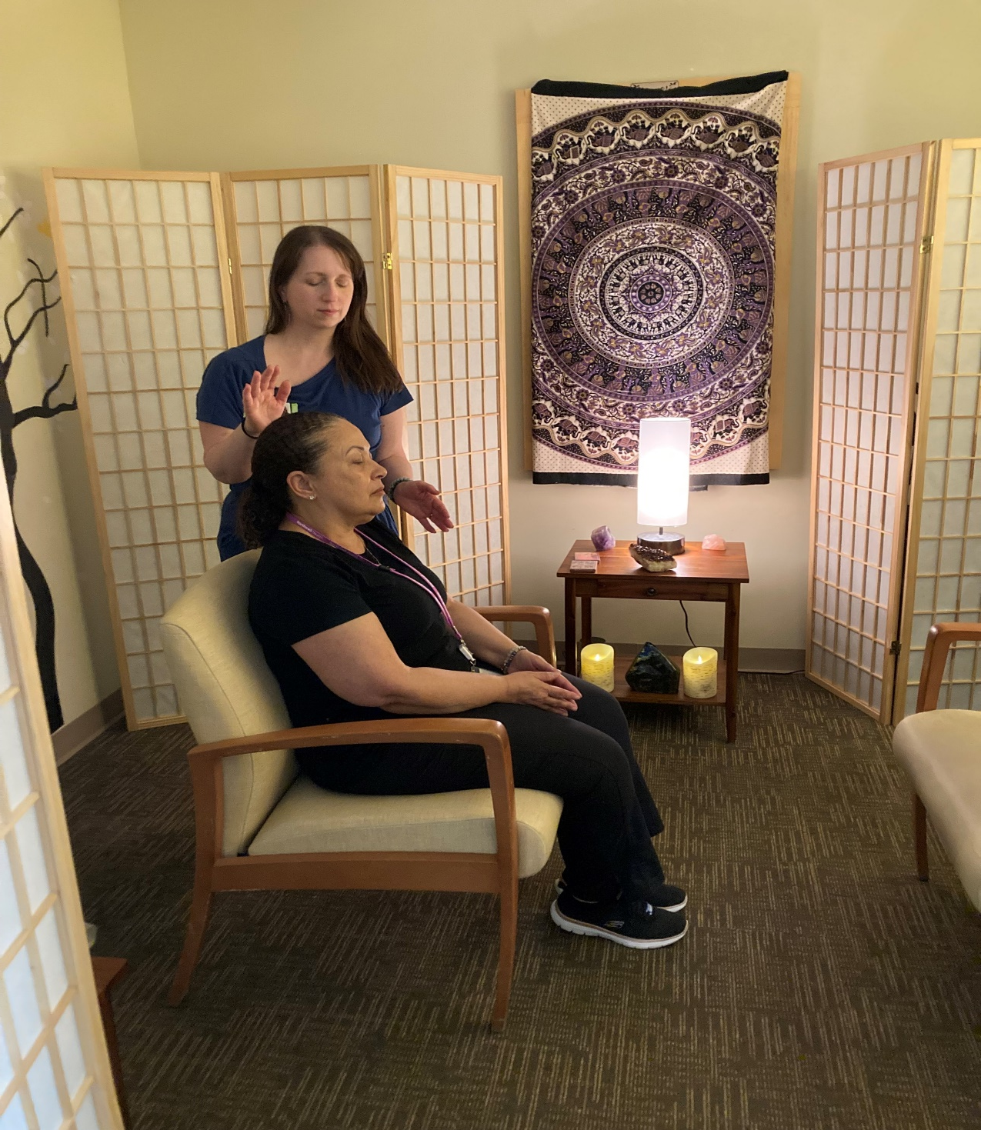
An energy practice used for stress management and the promotion of deep relaxation ​
Reiki
Universal Energy

Slide 15
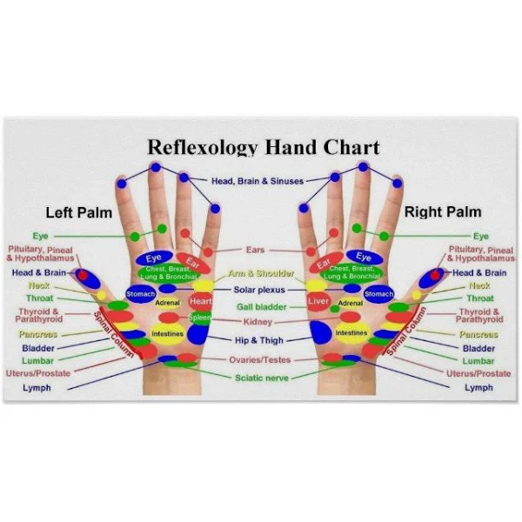
Reflexology
A therapeutic technique in which pressure is applied to specific parts of the hands or feet with the goal of inducing relaxation

Slide 16
SUPPORTIVE Listening
A form of Holistic Communication that is grounding for both the practitioner and client
It is the Heart-Centered process of holding space and being in the present moment with no agenda to cure or fix

Slide 17
The Serenity Suite: A Place of Peace
So relaxed their falling out of the chair = Recliners
Falling asleep
Family feedback = There’s no beeping…(Monitors)
Family feedback = I can cry in here
Some just come and sit
Some just come and talk
Sometimes they just wander in
You can feel the energy of the room/Door Nob
Never underestimate the healing power of a cup of tea/listening

Slide 18
Total Number of Holistic Sessions Offered in the Serenity Suite in 2023
(Family Caregivers and Staff) = 1,964 Sessions

Slide 19
Total Number of Holistic Sessions Offered in the Serenity Suite during the First Quarter 2024
(Family Caregivers and Staff) = 526 Sessions

Slide 20
OVERVIEW OF OUR In Room/In Patient Holistic Program
General Discomfort
Separation From Friend & Family

Slide 21
In-Room/In-Patient Program Challenges
Competition with other departments for patient’s time
Parent not present in the room to give consent
Parents/ patients sleeping in the room
Infection Prevention Precautions
Parents not able to leave the room due to acuity
Cultural or Religious Beliefs
Patient unable to relax around the parents or family

Slide 22
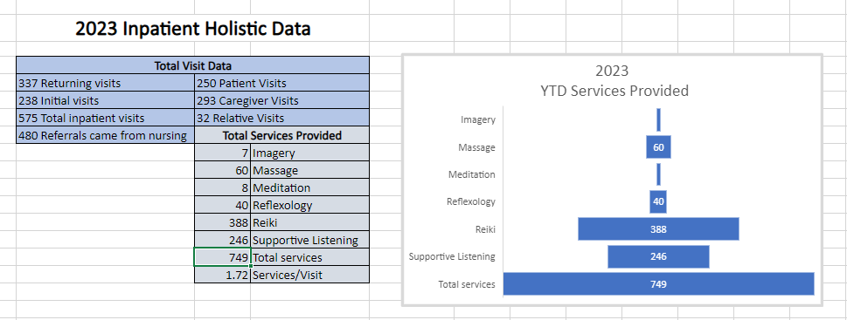
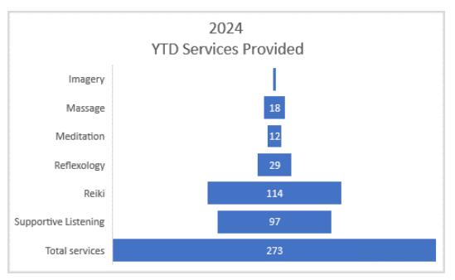
Total Number of Holistic Sessions Provide Through Our In-Room/In-Patient Program 2023
FIRST QUARTER 2024 = 273

Slide 23
How Do We Get Our Referrals?
Round with the Palliative Care Team
Social Work
Eating Disorder Program
Child Life
Creative Art Therapy
Chaplaincy
Nursing
Staff
Medicine
Hospital
Liaisons
OT/PT
Patient
Experience Team
Marketing Flyers with Online Scheduling

Slide 24
Palliative Diagnoses at CCMC
Genetic disorders
Cognitively challenged/ neurodiverse
Oncology
Trauma
Cardiac
Chronic long-term illness

Slide 25
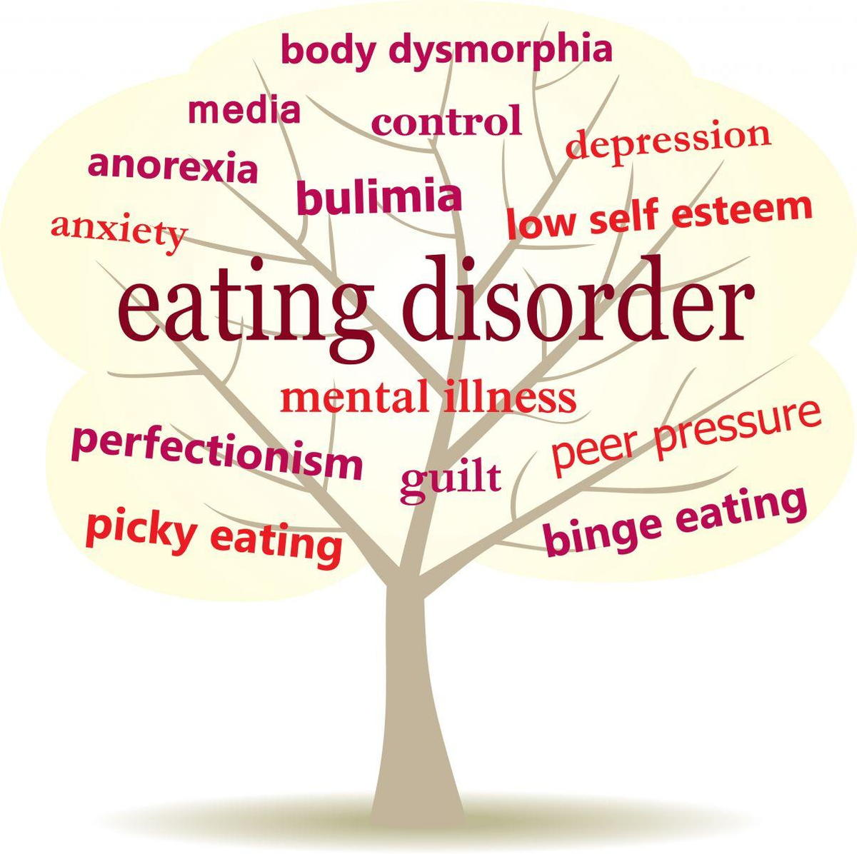
Eating Disorders Facts
Only 20% of adolescents with eating disorders seek treatment
Anorexia Nervosa has the Highest Mortality Rate of any Mental Illness
Can start as young as age 6
Affects all races, genders, and socioeconomic backgrounds

Slide 26
Culture Change Is About changing mindsets and attitudes
From I Don’t Have Time To…Selfcare Matters
The Steps Taken Along the Way

Slide 27
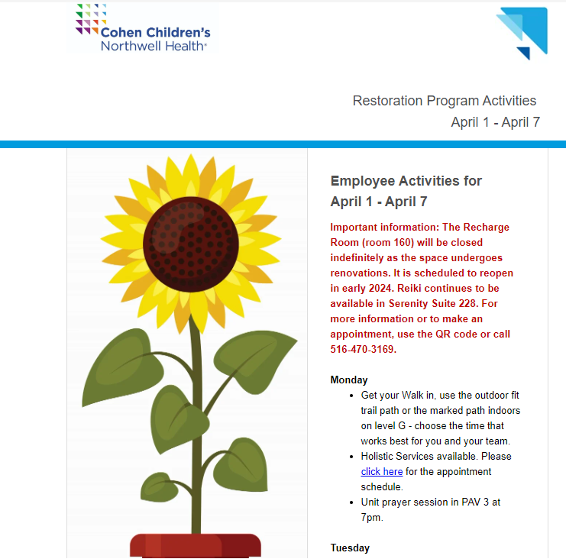
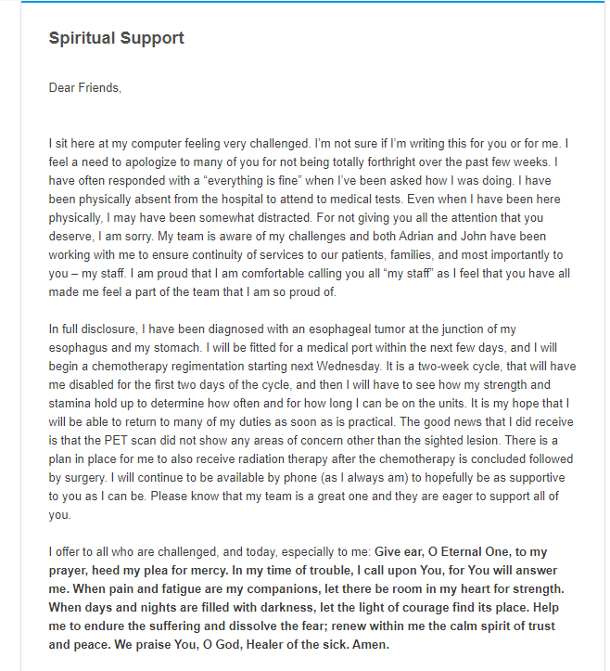
Weekly Restoration Newsletter

Slide 28
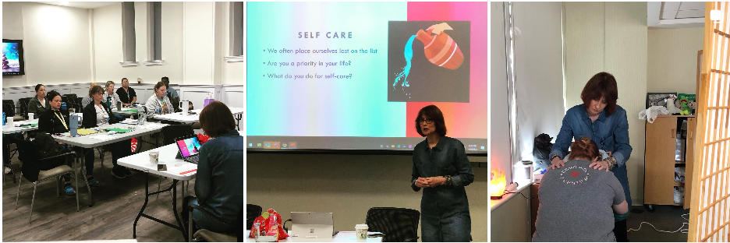
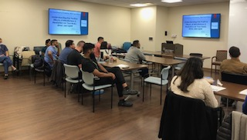
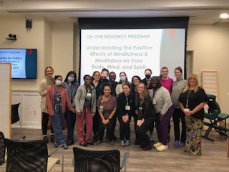
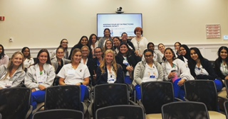
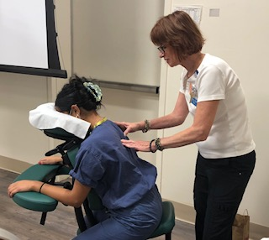
CAPITALIZING ON EVERY OPPORTUNITY TO MAKE THE MESSAGE OF SELFCARE COME ALIVE
NURSING GRAND ROUNDS
GYN RESIDENTS
3RD YEAR FELLOWS
NURSE RESIDENCY
BEHAVIORAL HEALTH RETREAT
3RD YEAR FELLOWS

Slide 29
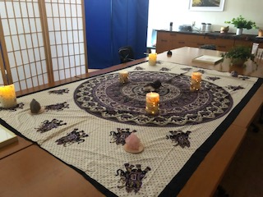
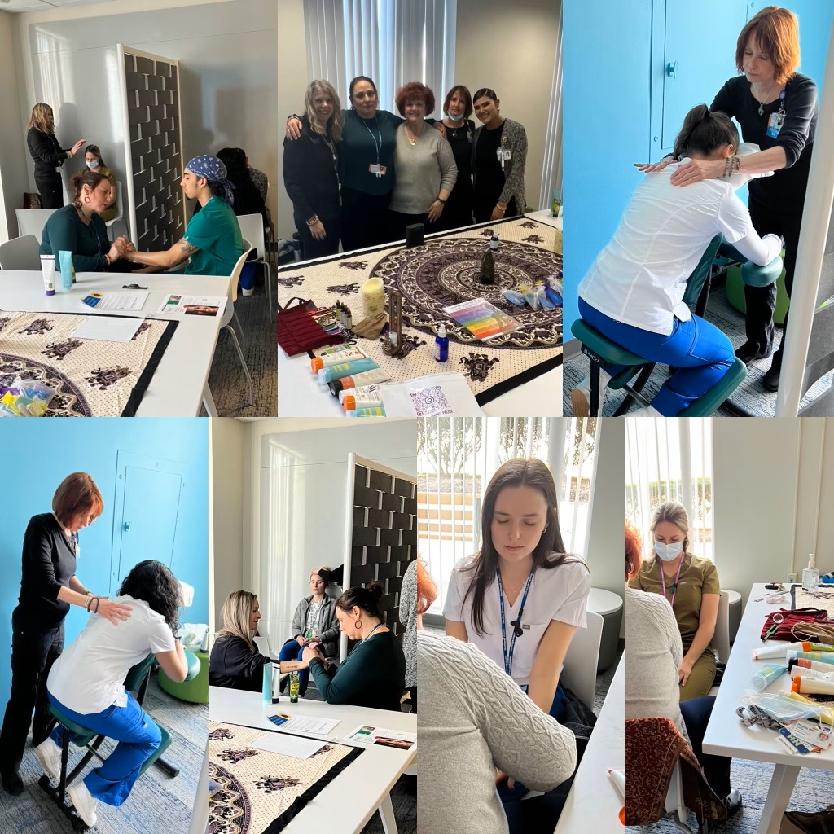
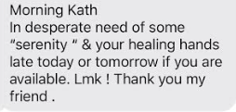
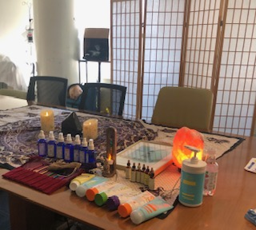
On Unit Holistic Pauses

Slide 30
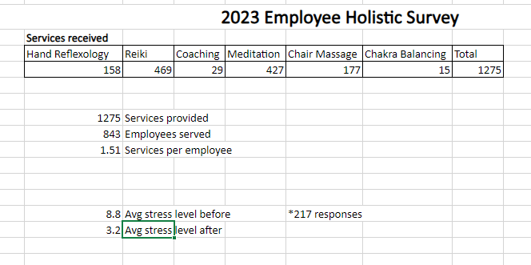
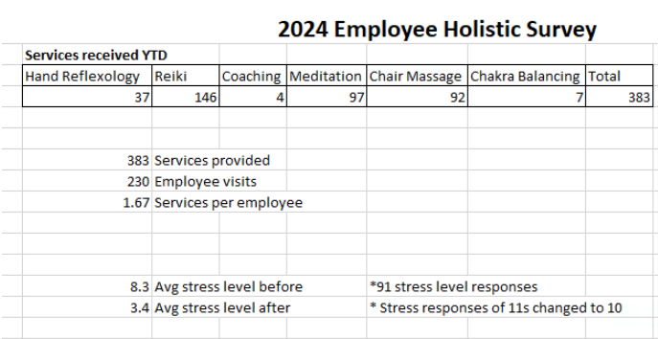
Number of Services Offered During Holistic Pause Events in 2023 = 1,275
OFFER IT..THEY WILL COME
FIRST QUARTER =383
Staff Reported a 5.6 Point Reduction in Their Perceived Stress Level After Their Service
Staff Reported a 4.9 Point Reduction in Their Perceived Stress Level After Their Service
Total Number of Coaching/Holistic Sessions
Offered Staff During Our Holistic Pause Events

Slide 31
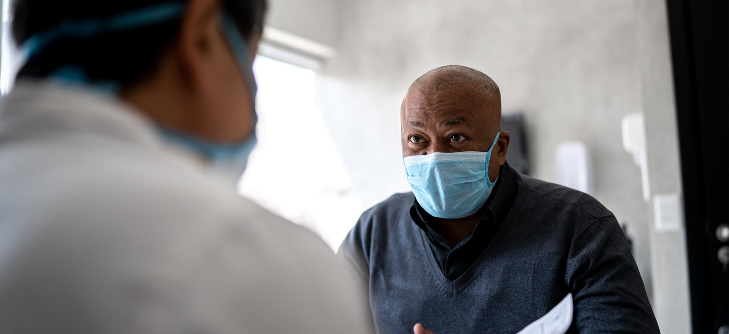
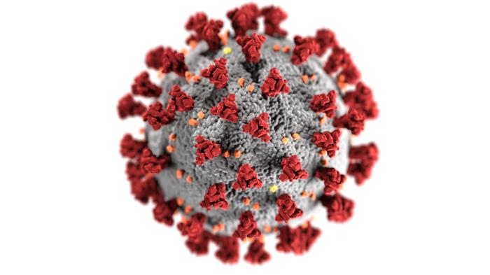
Holistic Services in a Time of COVID

Slide 32
Recharge Room
Available for Staff and Family Caregivers
Distance Reiki Sessions
(3) Electronic Massage Chairs = Hand Free
Foot Booties/Head Barriers/Vinyl Covering
15-minute sessions
Staff and Family Caregivers used a QR code to sign up for online appointments

Slide 33
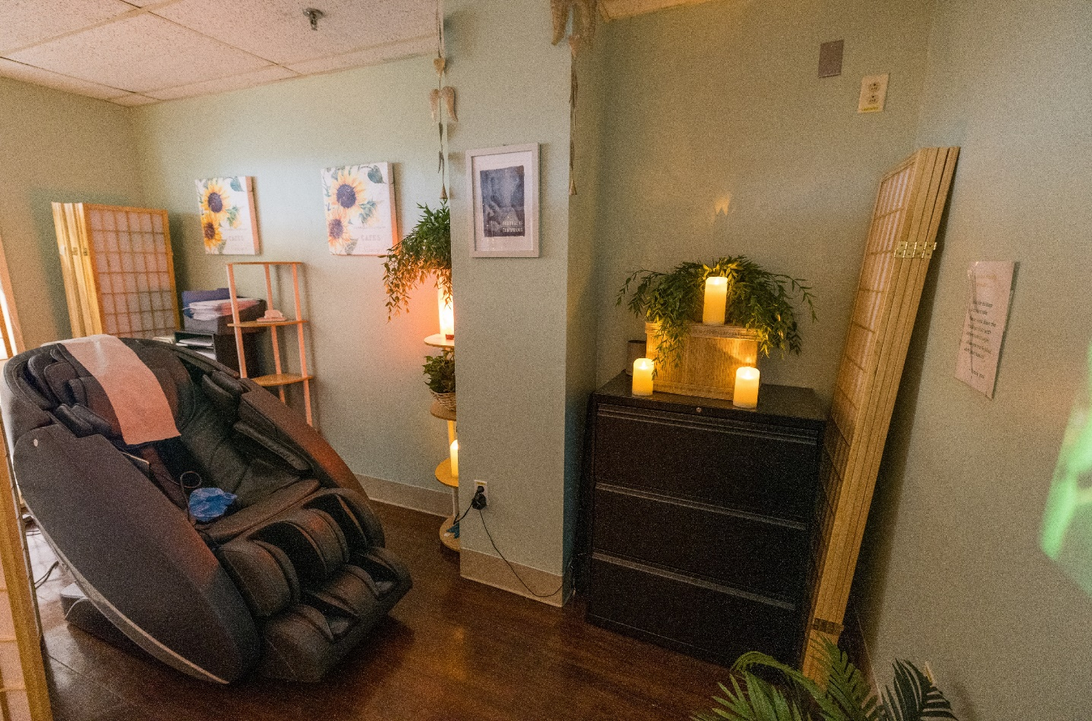
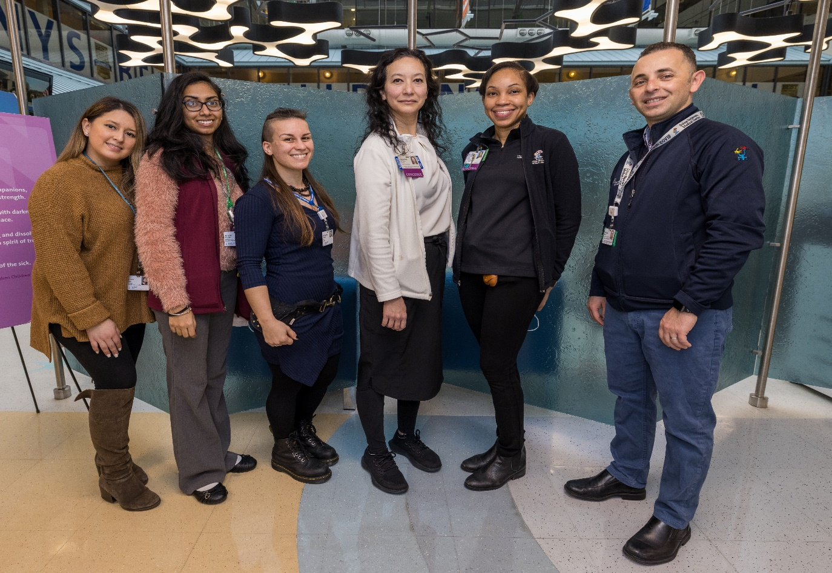
Recharge Room
Electronic Massage Chairs
HOSPITAL LIAISON TEAM
2021
In 2021, the CCMC staff enjoyed over 4,300
sessions in the electronic massage chairs
2022
In 2022 the staff enjoyed over 3,800 sessions in from January to September.
Recharge Room closed in September/Used for RSV Surge Space

Slide 34
Grant Research Published by the Beryl Institute in March 2023
155 family caregivers participated in the research
Perceived stress level Stress level measured using a Likert scale 0-10
154 participants reported a pre-session perceived stress level of 5 or greater
131 of those surveyed scored their post-session perceived stress level as 5 or less
The average pre-session perceived stress level was 8.77
The average post-session perceived stress level was 3.31
On average, the family caregiver’s perceived stress level was reduced by an impressive 5.46 (62%) after they enjoyed just a 15-minute session in our electronic massage chair

Slide 35
Funding
The
Vision
Administration's role in providing funds and other support is INVALUABLE
Donations and other creative means of underwriting our services
Generous donation from local citizen for purchase of commercial electronic massage chair
Partnership with community organizations
Participate in Cash Prize Northwell Health competitions
Training and speaking engagements for various professional organizations throughout NY State

Slide 36
LOOKING FORWARD TO WHAT’S NEXT…
HOW ELSE CAN WE BE OF SERVICE?

Slide 37
Hope to Create a Dedicated Family Caregiver Page
on the CCMC Website

Slide 38
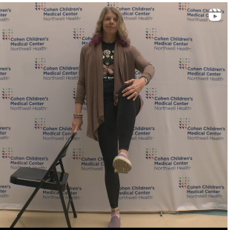
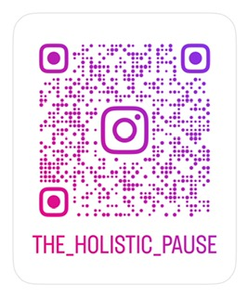
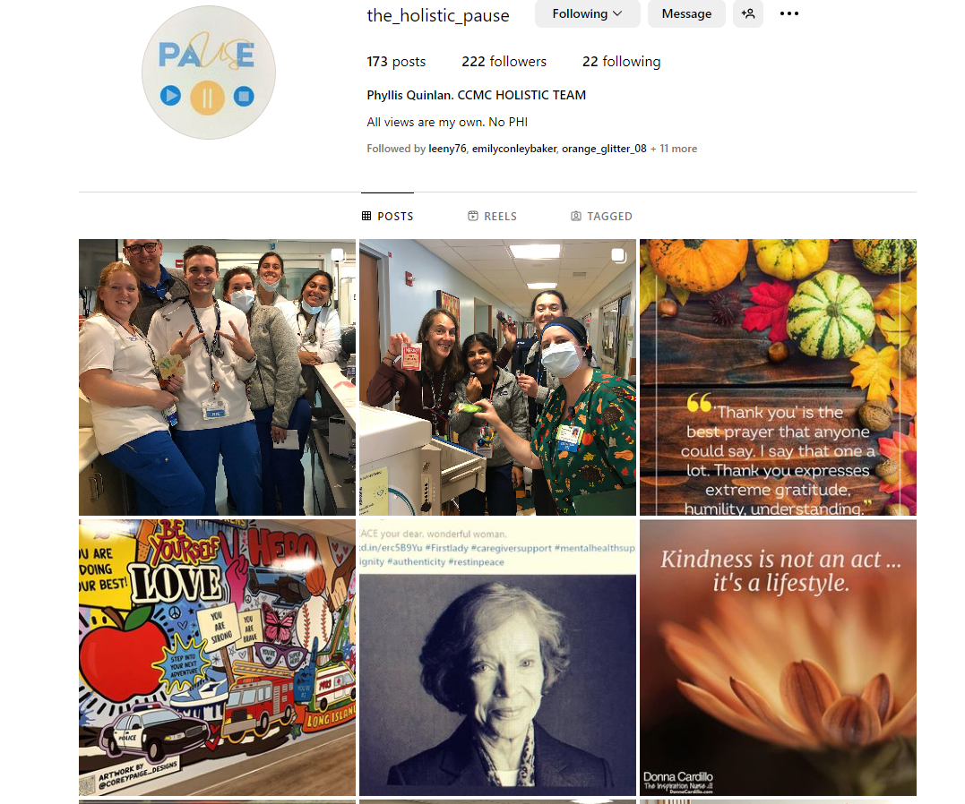
Holistic Instagram Page

Slide 39
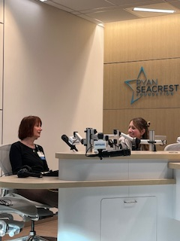
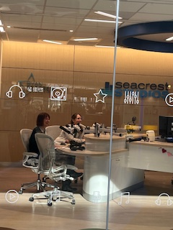
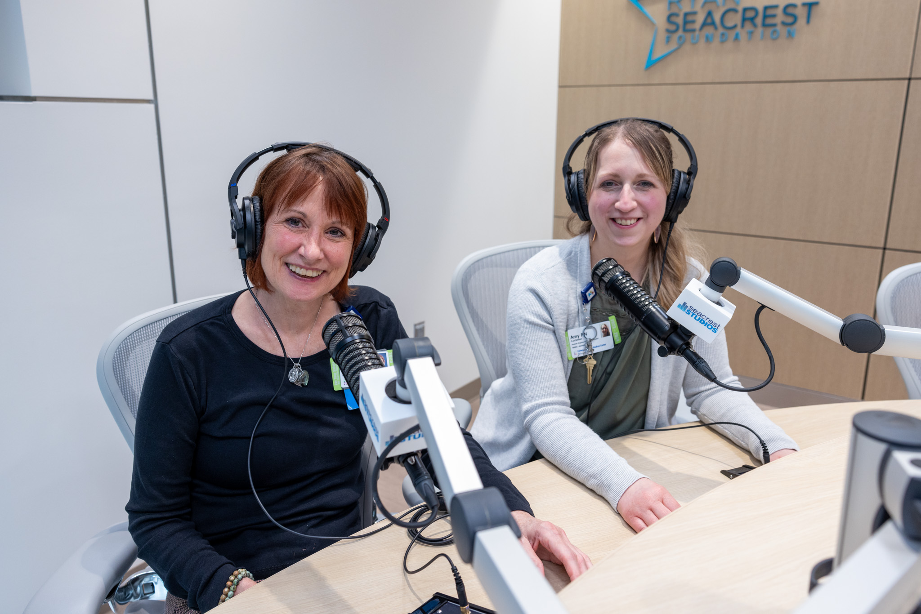
Strategic Partnership with the Ryan Seacrest Studio
We partnered with the Ryan Seacrest Studio to record several sessions that will offer our patients age-appropriate guided meditation in Safety/Protection, Grounding, and Bedtime Relaxation
Feedback from our Executive Director: Cari Quinn, MSN, RN “Wow, wow, wow, wow! I’m overwhelmed. Your team are nothing short of angels that are gracing us all with their gifts!!!! Wow.

Slide 40
AROMATHERAPY PROGRAM
Initial Idea 2020
Kathleen Nationally Certified
Building for Sustainability
Clinical Grade Essential Oils
Quality Measure Undergo JC Scrutiny
Funding to Support
Initial Program
JC Compliant
Policy & Procedure

Slide 41
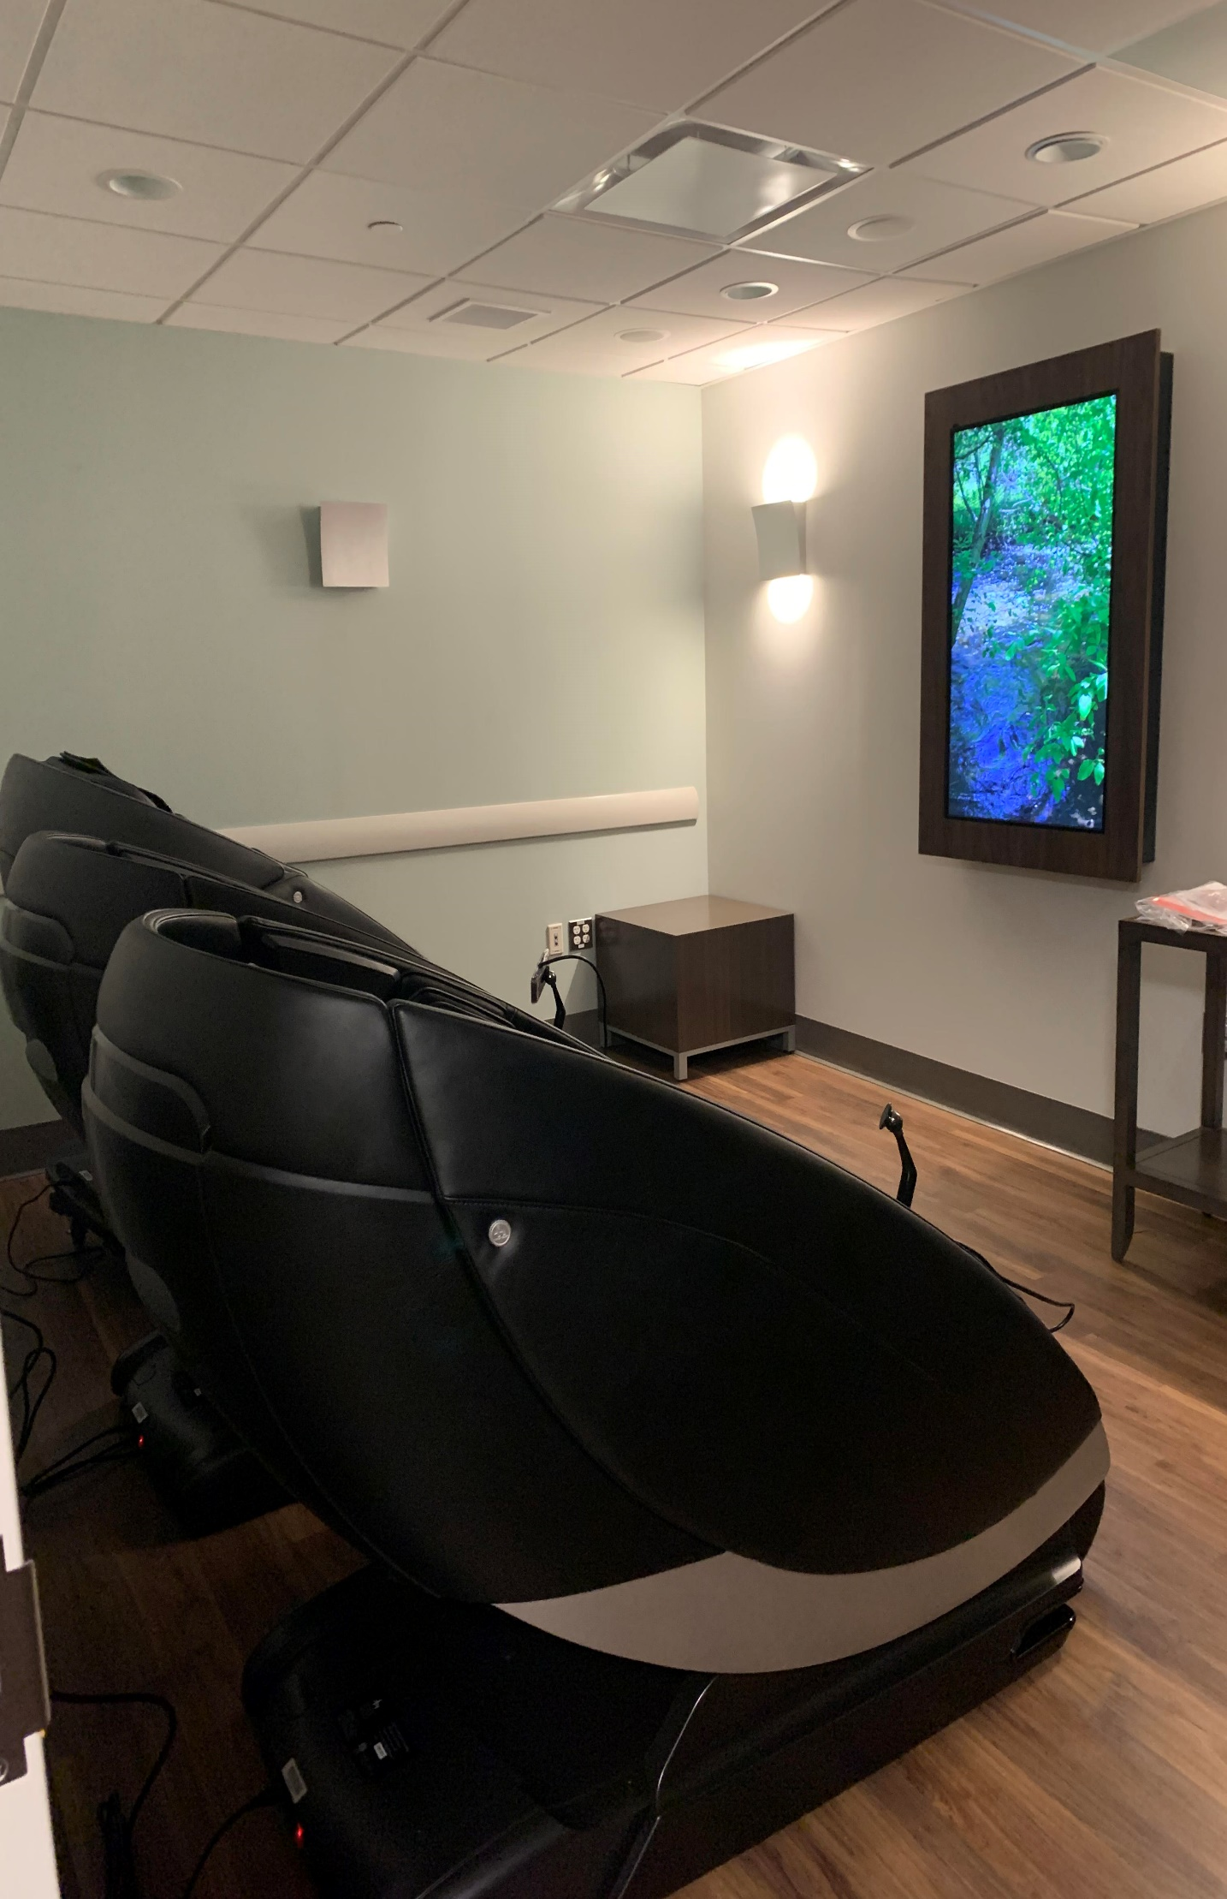
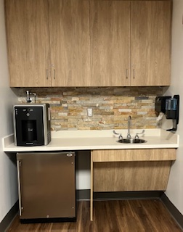
NEW CCMC INTEGRATED HOLISTIC CENTER
UNDER CONSTRUCTION
SCHEDULED TO OPEN IN
JUNE OF 2024
Double + the footprint of the Serenity Suite
Three Electronic Massage Chairs Available

Slide 42
What Were the Milestones that Signaled Culture Change Along the Way?
Kathleen’s status to
Full-Time Holistic RN
Opening Serenity Suite
Adding Holistic Nurses and Reiki Practitioners
to per diem staff
Holistic RNs included in Palliative Services Rounding
Engineering staff started asking for Reiki appointments
Acceptance of
In-Room/In Patient services
Increase in referrals from all departments
Creation of Oasis Space during COVID
Purchase of the electronic massage chairs
Oasis Space closed to allow building of a NeuroScience Unit
Staff petitioned administration for Oasis Space to reopening
Administration requesting Guided Meditation in C-Suite weekly
Holistic Services was added to content of New Hire Orientation
Numbers of staff using electronic massage chairs justified purchase
of 2 additional chairs
Departments requesting (weekly/monthly
services for staff
Administration found the $$$ to build our new Integrated Holistic Center

Slide 43
Lessons Learned
Executive support is VITAL
The program does not generate revenue therefore it is imperative to continually educate Administration on the impact of the Program for staff, patients, and families. The VALUE of the Program is PRICELESS!
Important to participate in Interprofessional orientation programs
Flexibility is important so that you can meet with needs of the off-shift staff at least quarterly
Do Not purchase residential electronic massage chairs/ Commercial chairs only
Hospital Liaison staff and volunteers are invaluable
Make tests of change as you navigate your organization’s changing culture
Remember This Is Pioneer Work

Slide 44
Thank You for Your Attention
kokane@northwell.edu
crossi4@northwell.edu aluckman1@northwell.edu

Slide 46
References
American Holistic Nurses Association https://www.ahna.org/Home/Resources American Holistic Nurses Association and American Nurses Association (2019). Holistic Nursing: Scope and Standards of Practice. Second edition. Silver Springs: ANA Dossey, B., Keegan, L. & Guzetta, C. (2022). Holistic Nursing a Handbook for Practice. Eighth edition. Boston: Jones and Bartlett Publishers. Ghaderi, F., & Solhjou, N. (2020). The effects of lavender aromatherapy on stress and pain perception in children during dental treatment: A randomized clinical trial. Complementary Therapies in Clinical Practice, 40, 101182. https://doi.org/10.1016/j.ctcp.2020.101182 https://www.eatingdisorderscoalition.org/inner_template/facts_and_info/facts-about-eating-disorders.html

Slide 47
American Holistic Nurses Association
Professional Organization
The AHNA is a specialty nursing association serving over 5,000 nurses and other holistic healthcare professionals whose Vision is a world in which nursing nurtures wholeness and inspires peace and healing
AHNA is well known as the definitive voice for holistic nursing through continuing education, research, practice, networking, and advocacy
Membership benefits: CEU’s, Beginnings magazine, Journal of Holistic Nursing and Long Island Chapter meetings
https://www.ahna.org

